Slide 1

The Technology Value Stream
Lead Time vs. Processing Time • From Months to Minutes with DevOps
Prepared for: Vaneshiea Bell

Slide 2

What is the Technology Value Stream?
The end‑to‑end flow of work from idea → development → operations → customer (and feedback back to development).
Focus: make work visible, reduce handoffs, improve flow, and increase quality.
Measured with lead time, processing (cycle) time, and % Complete & Accurate (%C/A).

Slide 3
Key Metrics in the Value Stream
Lead Time: total elapsed time from request/commit to running in production.
Processing (Cycle) Time: the actual hands‑on time to complete a step or change.
% Complete & Accurate: quality of outputs handed to the next step (no rework needed).

Slide 4
Lead Time vs. Processing Time (Course Textbook p. 9)
Lead Time = waiting + work time across the entire flow (what customers experience).
Processing Time = touch time actually spent doing the work in a given step.
Implication: Long queues, approvals, or environment waits stretch lead time even when processing time is short.

Slide 5
Common Scenario—Deployments Take Months (Course Textbook p. 10)
Symptoms: long manual test cycles, change advisory boards, environment bottlenecks, and handoffs across silos.
Result: release lead times measured in months and painful weekends/late‑night deployments.
Recent data point: many orgs report average deployment delays ≈ 3.8 months due to skills gaps and low automation.

Slide 6
DevOps Ideal—Deployments in Minutes (Course Textbook p. 10)
Automated CI/CD pipelines: build → test → security → deploy with minimal human gates.
Small batch sizes & trunk‑based development enable frequent, low‑risk releases.
Infrastructure as Code, automated rollback, and observability make deployments routine and reversible.

Slide 7
How to Move from Months → Minutes
Map the value stream: capture lead vs. processing time at each step; remove bottlenecks.
Automate everything credible: builds, tests, security checks, deployments, and infra provisioning.
Limit WIP; use feature flags; decouple releases from deploys; measure DORA metrics to guide improvement.

Slide 8
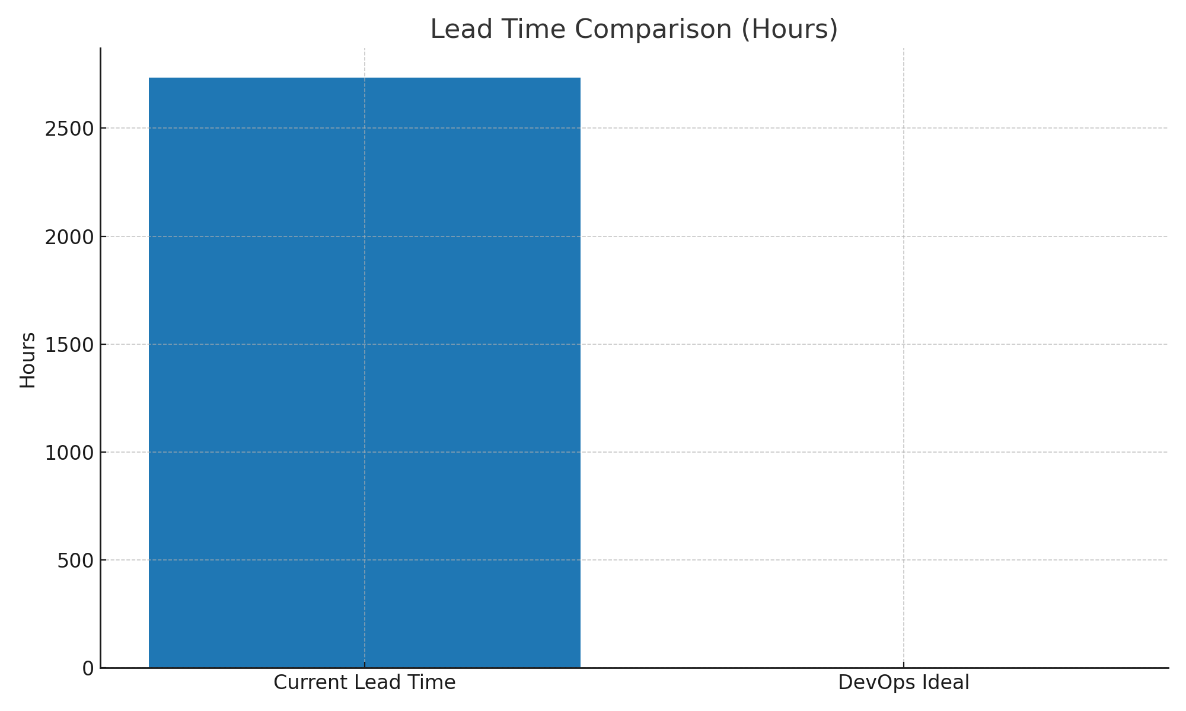
Graphic—Lead Time Now vs. Ideal (Hours)

Slide 9

References & Citations
IT Revolution: "Understanding the Work in Our Value Stream and Improving Flow" (value stream, metrics, %C/A).
IT Revolution: "Cycle Time vs. Lead Time" (differences and definitions).
Atlassian: "4 Key DevOps Metrics to Know" (lead time for changes).
Google Cloud Blog: "Using the Four Keys to measure your DevOps performance" (lead time measurement).
Gearset study via ITPro: "Software deployments are plagued by delays" (avg ~3.8 months delays).
Readingraphics: "Book Summary – The DevOps Handbook" (DevOps goal: accelerate flow).
Course Textbook: pp. 9–10 (lead time vs processing time; months → minutes scenario).

